Slide 1

AICA LEVEL 2 · B 121
CreditSight
Explainable credit risk.
Predictive liquidity intelligence.
From customer assessment to cash-flow decisions
CA Rajan Subramanian
Member No. 200069 · Dubai, UAE
Notes:
Welcome. CreditSight connects customer credit risk, receivables and cash forecasting in one explainable workflow. This is a synthetic demonstration portfolio.

Slide 2
OBJECTIVES
One cockpit for three decision-makers
01
02
03
Credit manager
Collections team
CFO / treasury
THE QUESTION
THE QUESTION
THE QUESTION
Is this limit prudent, and why?
Who should we call first, and what is promised?
Will cash stay above the floor under stress?
Assess risk and review prudent credit limits with visible factor explanations.
Prioritise customers and connect payment commitments to expected receipts.
Stress cash assumptions, spot funding pressure and document each decision.
Notes:
Each persona has a different question. The same data should answer all three.

Slide 3
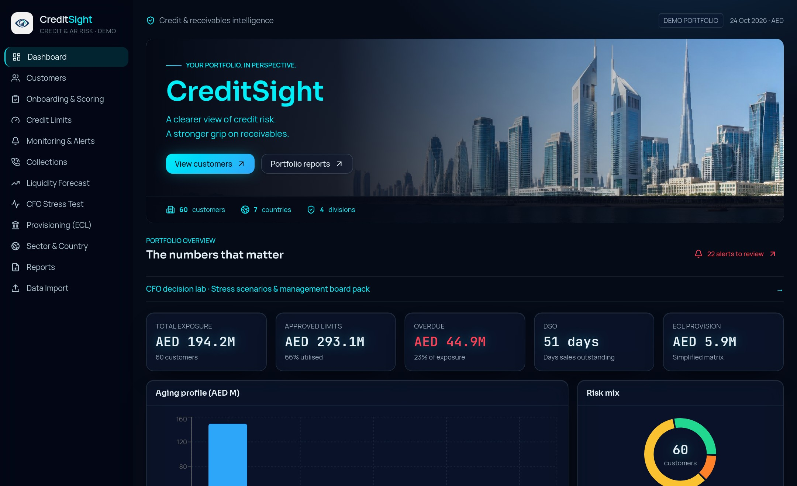
DATA FOUNDATION
A demonstration portfolio tests the logic
60
synthetic customers
4 · 7 · 8
divisions · countries · sectors
AED 293.15M
approved limits, 66% utilised
51 days
days sales outstanding (DSO)
Portfolio dashboard: exposure, overdue, DSO and ECL on one screen.
Notes:
The portfolio is synthetic, so the figures show how the logic behaves, not a real client position.

Slide 4
END-TO-END FLOW
From customer to cash, in five steps
1
2
3
4
5
Customer
Credit
Sales
Liquidity
Collection
Master data, risk profile and approved limit set up.
Score, band and limit reviewed by the credit team.
Invoices create receivables against the approved limit.
Invoices and promises become dated, probability-weighted receipts.
Risk-led worklist prioritised by overdue value, with actions logged.
A decision narrative, not an automated process: CreditSight recommends and documents; management decides and executes.
Notes:
Walk left to right. Stress the point that CreditSight recommends and documents; people decide and execute.

Slide 5
CREDIT SCORING
Scorecard v1.3: explainable, not a black box
Data coverage
Missing inputs reduce confidence, and the factors present are rescaled.
Override warnings
Adverse knock-outs can cap the final score.
Risk bands
75+ Low · 55–74 Medium · 35–54 High · below 35 Critical. Both v1.2 and v1.3 are selectable.
Notes:
Weights total 100 points. Payment history is the largest single factor. Be clear that scores are review inputs, not bureau ratings.

Slide 6
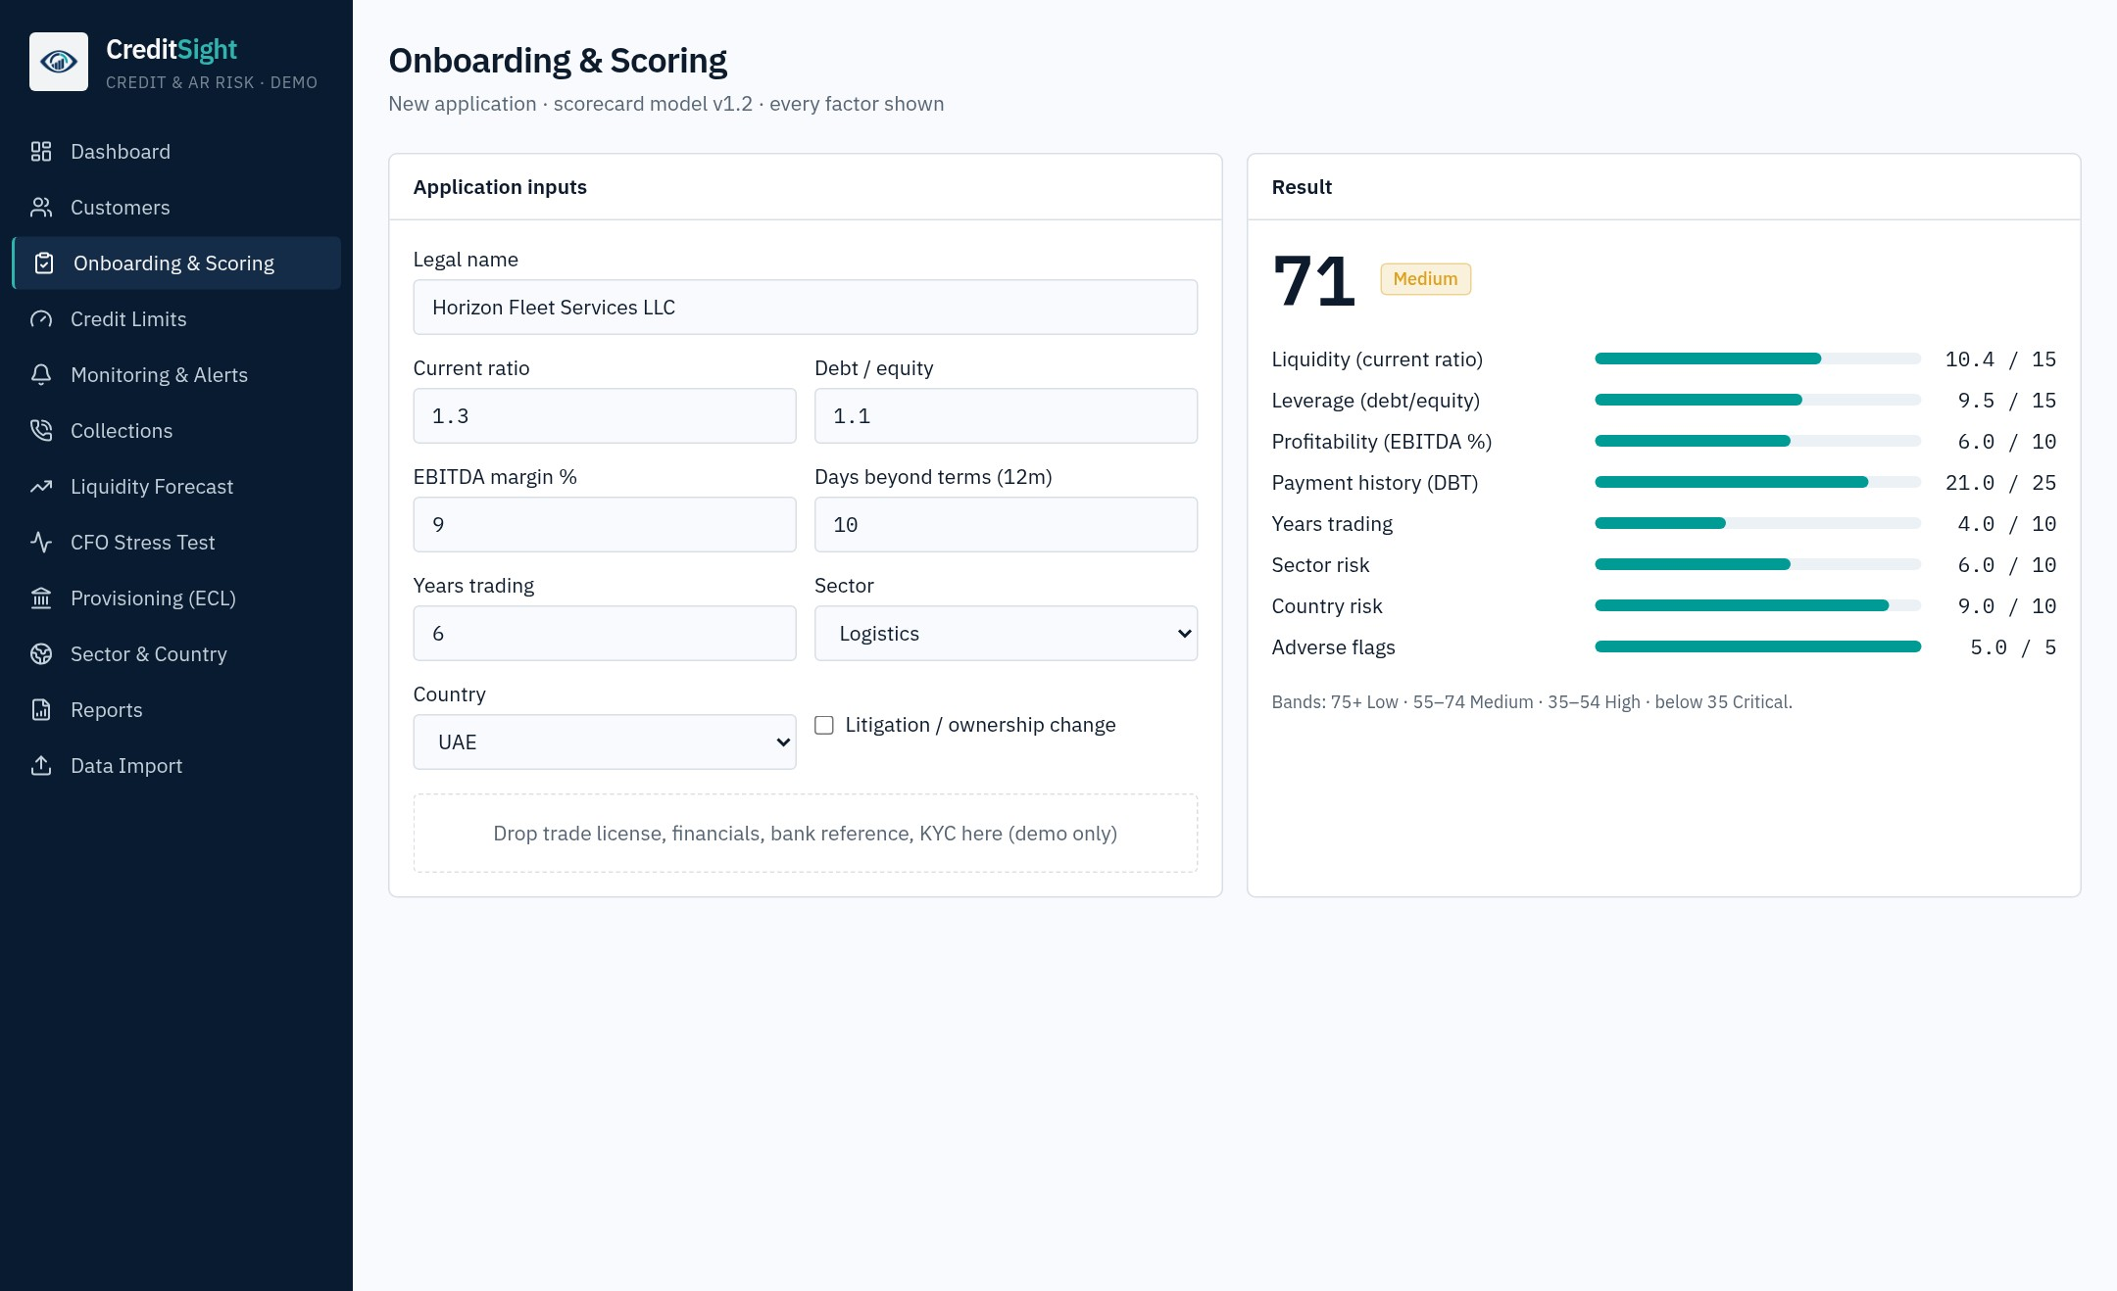
CREDIT POLICY
Conservative credit limits from three methods
Net-worth method
01
10% of the customer's net worth.
Sales and terms method
02
Monthly revenue × terms ÷ 30 × 1.2 × 15%.
Score-tier method
03
Annual revenue × 5% × risk-score tier factor.
Onboarding: score, risk band and recommended action with factor-level detail.
Notes:
Three methods, each conservative. Limits are a recommendation for credit-manager review. The onboarding screen shows the score, band and warnings for a new application.

Slide 7
RECEIVABLES HEALTH
Most exposure is current; AED 45M is overdue
AED 44.95M
overdue, 23.1% of AED 194.24M exposure
AED 6.74M
in the 90+ bucket, the highest-loss tier
51 days
days sales outstanding across the portfolio
Notes:
Current balances are AED 149.29M. Overdue balances total AED 44.95M, and the 90+ bucket is AED 6.74M.

Slide 8
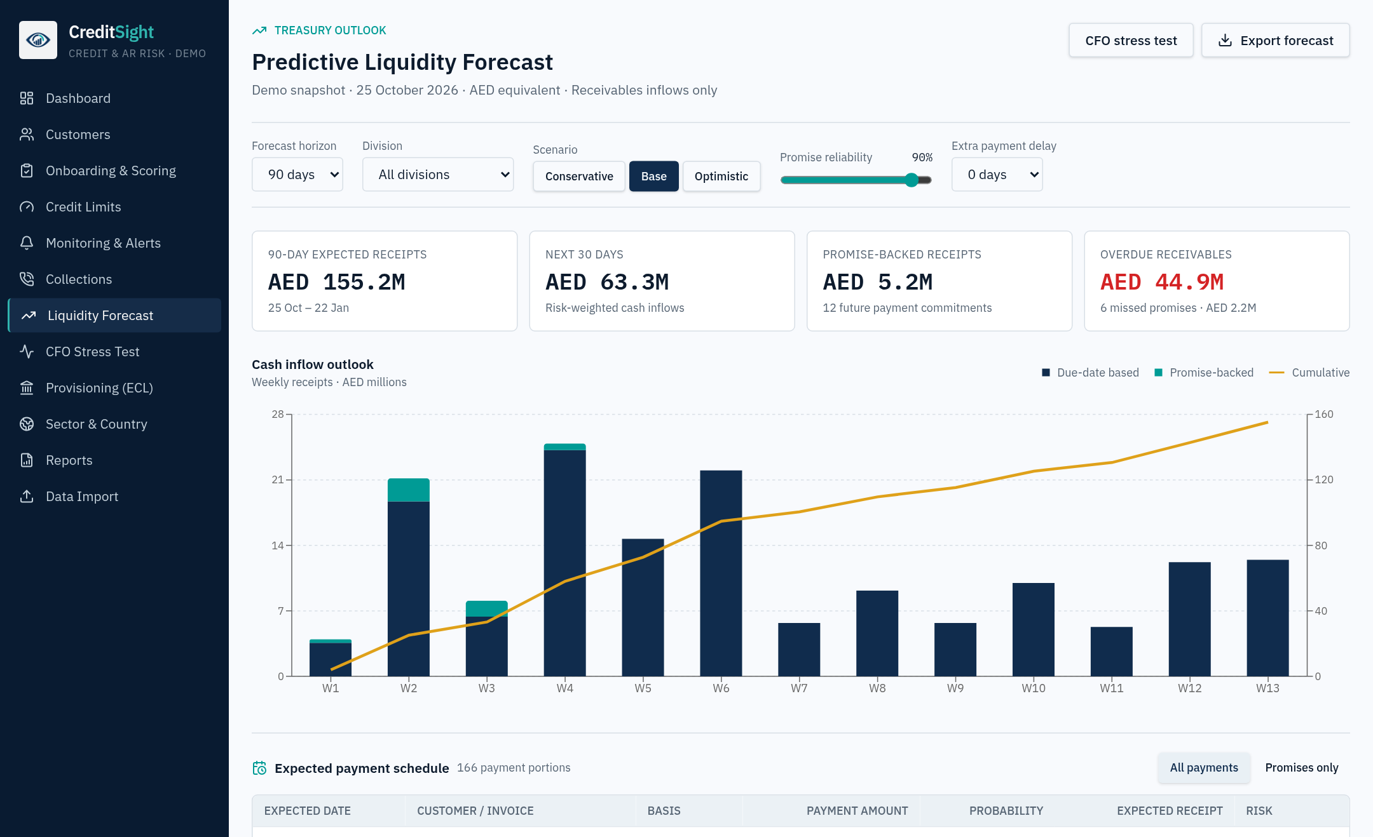
LIQUIDITY FORECAST
Expected receipts start at the invoice
01
Allocate principal once
Split valid future promise amounts from the remaining due-date balance.
02
Estimate timing
Use invoice dates, historical days beyond terms, and a fallback for missed promises.
03
Weight probability
Apply customer-risk probability and promise-reliability assumptions.
155.2M
63.3M
5.2M
AED 90-day receipts
AED next 30 days
AED promise-backed, 12 commitments
Base, optimistic and conservative views, with invoice-level allocations behind each total.
Notes:
Walk through the three steps. The key control: principal is allocated once, so promises and invoice balances are never double counted.

Slide 9
CFO STRESS TESTING
Five CFO scenarios test the cash floor
Opening cash + expected receipts − operating outflows
Illustrative inputs: AED 5M opening cash · AED 8M base weekly outflows · AED 2M minimum cash floor
01
02
03
04
05
Base case
Regional slowdown
Largest customer defaults
Liquidity crunch
Collections push
Payments arrive as forecast, at 90% promise reliability.
Customers pay 30 days late; 40% of promises broken.
Biggest exposure stops paying; 14-day delays elsewhere.
21-day delays, 60% of promises broken, outflows up 25%.
On-time payments, promises kept, outflows cut 25%.
Notes:
The identity is simple: opening cash plus expected receipts less outflows must stay above the floor. The five scenarios change one or more of these inputs.

Slide 10
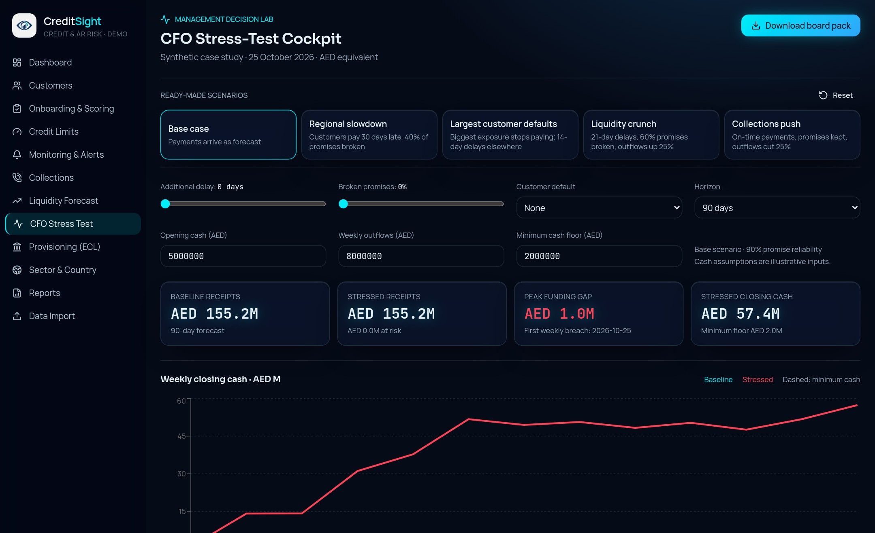
DEMONSTRATED RESULT
A liquidity crunch opens an AED 33M gap
AED 33.27M
peak cash-floor shortfall against the AED 2M floor
AED 122.17M
stressed 90-day receipts, against AED 155.23M baseline
−AED 1.40M
closing cash at day 90
Liquidity crunch assumptions: 21-day customer delays · 60% broken promises · AED 10M weekly outflows
CFO stress-test cockpit: scenario selectors, cash floor and weekly closing cash.
Notes:
Headline the peak gap, not the closing cash. Closing cash at day 90 is negative, so the floor breach is the story.

Slide 11
PROVISIONING (ILLUSTRATIVE)
Illustrative ECL of AED 6.46M, 3.32% coverage
Age bucket | Balance (AED M) | Policy loss rate | ECL (AED M)
Current | 149.29 | 0.5% | 0.82
1–30 days | 20.23 | 2% | 0.44
31–60 days | 11.24 | 6% | 0.74
61–90 days | 6.74 | 15% | 1.11
90+ days | 6.74 | 45% | 3.34
Total | 194.24 |  | 6.46
AED 194.24M
gross receivables
AED 6.46M
ECL provision, with overlay
3.32%
coverage of gross receivables
Loss rates are editable policy assumptions. ECL includes a +10% forward-looking overlay (base AED 5.9M). Totals may differ by AED 0.01M due to rounding.
Not an approved IFRS 9 impairment charge. Loss rates are policy assumptions for finance review.
Notes:
Be explicit: this is an illustrative aging-matrix view for finance review. It is not an approved IFRS 9 charge. Loss rates are policy assumptions.

Slide 12
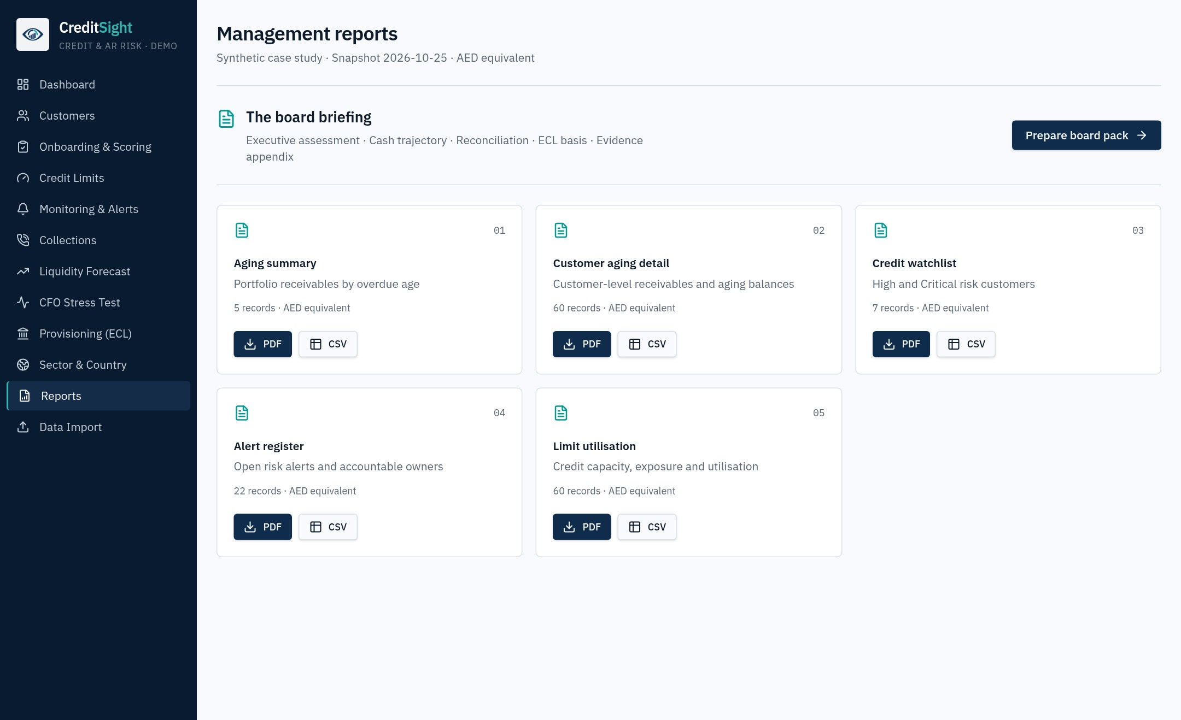
REPORTING
Reports reconciled to the portfolio view
Five portfolio reports, each in PDF and CSV
01
Aging summary
02
Customer aging detail
03
Credit watchlist
04
Alert register
05
Limit utilisation
Scenario board pack with stated assumptions
Invoice-level evidence with pagination
Management reports: PDF and CSV outputs that tie back to the dashboard totals.
Notes:
Five portfolio reports, each in PDF and CSV, plus a scenario board pack and invoice-level evidence. Totals reconcile to the dashboard.

Slide 13
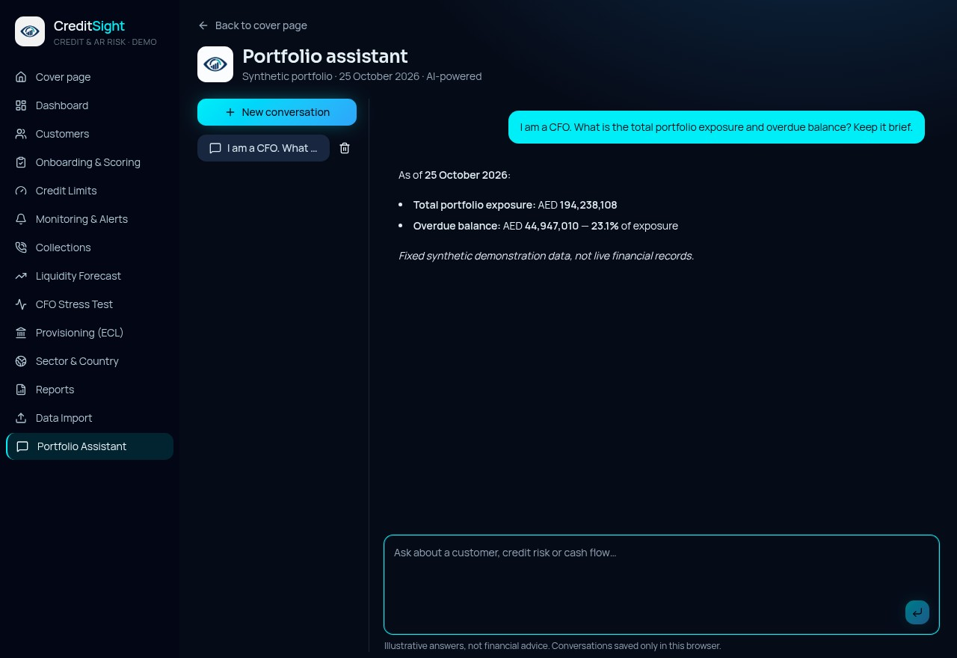
AI ENHANCEMENT
A portfolio assistant grounded in the data
Multi-turn answers
01
Follow-up questions keep their context within a conversation.
Real model responses
02
Model access is server-only and grounded in the current portfolio context.
Private chat history
03
Conversations are saved only in the user's browser. Answers are illustrative, not financial advice.
Portfolio assistant: multi-turn answers, saved only in this browser.
Notes:
The assistant answers from portfolio context. Model access runs on the server only. Conversations stay in the browser and answers are illustrative, not advice.

Slide 14
IMPLEMENTATION
Deterministic core, real AI at the boundary
01
02
03
Presentation
Decision core
AI boundary
Light and Cyber-Glass interface
Mobile home-screen support
Browser PDF and CSV export
Deterministic demo data
Pure scoring and forecast logic
Stress and ECL calculations
Server-only model access
Grounded portfolio context
Browser-held chat history
Not yet built: live ERP, bank or bureau connections, and production role-based approvals.
Notes:
This is an honest architecture. The decision logic is deterministic and testable. AI is confined to a server-side boundary.

Slide 15
QUALITY ASSURANCE
Validation focuses on trust, not appearance
24
tests passed across five files, run on 1 November 2026
01
02
03
Traceable totals
Logic under test
Observed user flows
Invoice principal reconciles to exposure, and promises are not counted twice.
Scoring, forecast allocation, stress maths, routing and chat separation are covered.
Reports and scenario exports were checked, and AI follow-up and reload were verified.
Notes:
Lead with the 24 passing tests, then the reconciliation and the observed user flows. Be precise that these are demonstration-scope checks.

Slide 16
LIMITATIONS
What is unproven, and must be disclosed
01
02
03
Model accuracy
Treasury completeness
Production controls
Rules-based probabilities have not yet been backtested against actual receipts.
No live balances, new-sales forecast, tax calendar, financing or intraday view.
Workflow actions in the demo are not durable approvals or real collection automation.
Each limitation maps to a stage on the roadmap that follows.
Notes:
Disclosure is part of the design. Each limitation is mapped to a roadmap stage on the next slide.

Slide 17
NEXT STEPS
A production roadmap with release gates
01
02
03
STAGE 01
→
STAGE 02
→
STAGE 03
Connect and protect
Calibrate and backtest
Automate with oversight
ERP and ledger inputs, reconciled balances, sign-in and accountable roles.
Forecast-versus-actual analysis, score calibration and ECL policy overlays.
Approved alerts, durable audit trails and controlled AI access.
Release gate: each stage opens only when the previous stage's controls are in place.
Notes:
Stages are sequential. Each release gate requires the previous stage's controls to be in place before the next starts.

Slide 18
CONCLUSION
See credit risk before it becomes a cash gap.
Explainable methods · Connected decisions · Documented evidence
CA Rajan Subramanian
Member No. 200069 · Dubai, UAE · AICA Level 2 · B 121
Live project: creditsight.lovable.app
Notes:
Close on the conclusion, then invite questions. Mention the live project link for anyone who wants to explore the demo.

Slide 19
APPENDIX
Evidence and sources
01
Application source: deterministic portfolio, scorecard, liquidity and stress modules
02
Test run: 24 tests passed across five files, 1 November 2026
03
Product screenshots: captured for the capstone appendix, 1 November 2026
04
Scenario evidence: board pack and invoice-level allocations
05
External data references: AECB, Dun & Bradstreet, Creditsafe and official UAE licence portals
All figures come from a synthetic demonstration portfolio and are not live financial records.
Notes:
Reference slide for the examiner. Every figure traces to the synthetic demonstration portfolio.

